Slide 1

Ethics in Scientific Publication
بسم الله الرحمن الرحیم
Fariba Asghari, MD
Medical Ethics and History of Medicine Research Center
Tehran University of Medical Sciences
fasghari@tums.ac.ir

Slide 2

Question
What is the purpose of publication?

Slide 3
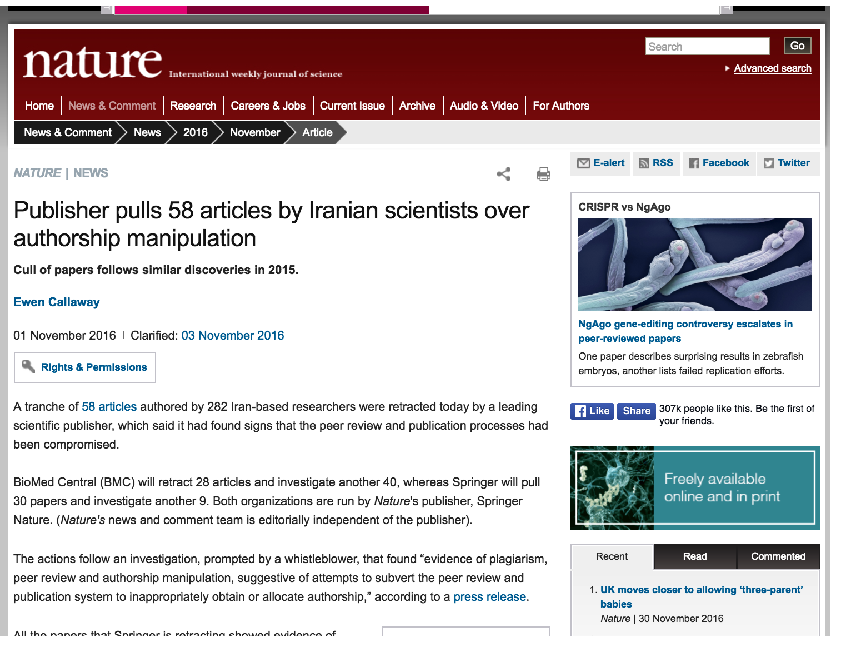

Slide 4
content
Data ownership
Authorship
Acknowledgement
Conflict of interest
Publication misconduct
  Ghost, Guest author
  Plagiarism
  Duplicate publication
  Redundant publication
  Falsification
  Fabrication

Slide 5
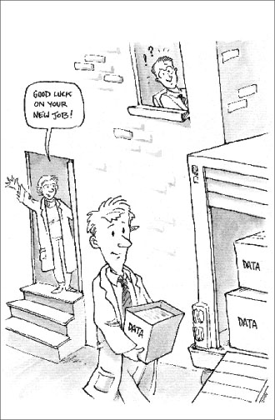
Data ownership
Who owns data?
Sponsor usually owns data and could hold or transfer publication license
both the possession of and responsibility

Slide 6
Authorship
An “author” is generally considered to be someone who has made substantive intellectual contributions to a published study

Slide 7
Authorship criteria
Substantial contributions to the conception or design of the work; or the acquisition, analysis, or interpretation of data for the work; AND
Drafting the work or revising it critically for important intellectual content; AND
Final approval of the version to be published; AND
Agreement to be accountable for all aspects of the work in ensuring that questions related to the accuracy or integrity of any part of the work are appropriately investigated and resolved.

Slide 8
Authors responsibility
All authors should be able to take public responsibility for the work and
should have full confidence in the accuracy and integrity of the work of other group authors.

Slide 9
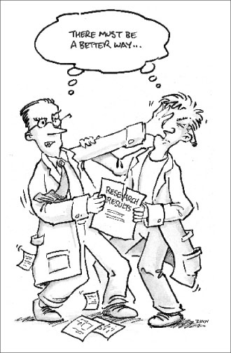
Authorship conflict
Who is first?
Who is corresponding author?
How to prevent authorship conflict?
What is contributionship?
Notes:
The corresponding author is the one individual who takes primary responsibility for communication with the journal during the manuscript submission, peer review, and publication process, and typically ensures that all the journal’s administrative requirements, such as providing details of authorship, ethics committee approval, clinical trial registration documentation, and gathering conflict of interest forms and statements, are properly completed, although these duties may be delegated to one or more coauthors. The corresponding author should be available throughout the submission and peer review process to respond to editorial queries in a timely way, and should be available after publication to respond to critiques of the work and cooperate with any requests from the journal for data or additional information should questions about the paper arise after publication

Slide 10
Competing manuscripts based on the same study
coworkers who disagree on the analysis and interpretation
  the authors should submit a manuscript that clearly presents both versions.
  The difference of opinion should be explained in a cover letter.
  The normal process of peer and editorial review may help the authors to resolve their disagreement regarding analysis or interpretation.
Notes:
III. D. 4. a. Differences in analysis or interpretation: If the dispute centers on the analysis or interpretation of data, the authors should submit a manuscript that clearly presents both versions. The difference of opinion should be explained in a cover letter. The normal process of peer and editorial review may help the authors to resolve their disagreement regarding analysis or interpretation.
If the dispute cannot be resolved and the study merits publication, both versions should be published. Options include publishing two papers on the same study, or a single paper with two analyses or interpretations. In such cases, it would be appropriate for the editor to publish a statement outlining the disagreement and the journal's involvement in attempts to resolve it.
III. D. 4. b. Differences in reported methods or results: If the dispute centers on differing opinions of what was actually done or observed during the study, the journal editor should refuse publication until the disagreement is resolved. Peer review cannot be expected to resolve such problems. If there are allegations of dishonesty or fraud, editors should inform the appropriate authorities; authors should be notified of an editor's intention to report a suspicion of research misconduct.

Slide 11
Artificial Intelligence(AI)
Chatbots (such as ChatGPT) should not be listed as authors
Authors have to disclose whether they used artificial intelligence
  Describe how they used it.
  in both the cover letter and the submitted work
Authors should carefully review and edit the result
Humans must ensure there is appropriate attribution of all quoted material, including full citations.

Slide 12
Acknowledgements
Contributors who meet fewer than all 4 of the above criteria
Examples of activities that alone do not qualify a contributor for authorship are:
  purely technical help,
  writing assistance
  a department chairperson who provided only general support.
  acquisition of funding
Their contributions should be specified
Corresponding author should obtain written permission to be acknowledged from all acknowledged individuals.

Slide 13
Conflict of Interest
Authors’ conflicts of interest; and
Sources of support for the work, including sponsor names along with explanations of the role of those sources if any
Whether the authors had access to the study data, with an explanation of the nature and extent of access, including whether access is ongoing.
Authors are responsible for disclosing all financial and personal relationships that might bias or be seen to bias their work.

Slide 14
Ethical Approval
When reporting experiments on human subjects, authors should indicate whether the procedures followed were in accordance with the ethical standards of the responsible committee on human experimentation

Slide 15
Preprints
Posting of work as a preprint may influence a journal’s interest in or priority for peer review and publication of that work.
Journals should clearly describe their policies

Slide 16

Publication Misconduct

Slide 17
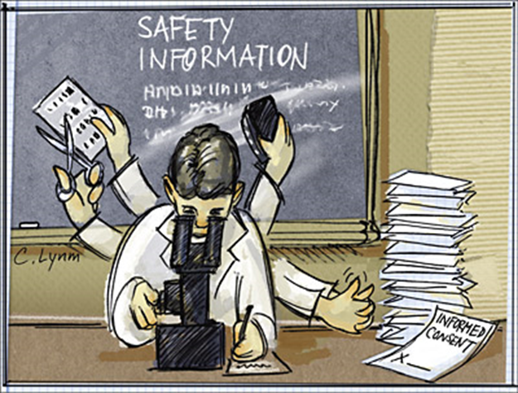
Publication Misconduct
Authorship
  Ghost, Guest
Plagiarism
Duplicate publication
Redundant publication
Falsification
Fabrication

Slide 18
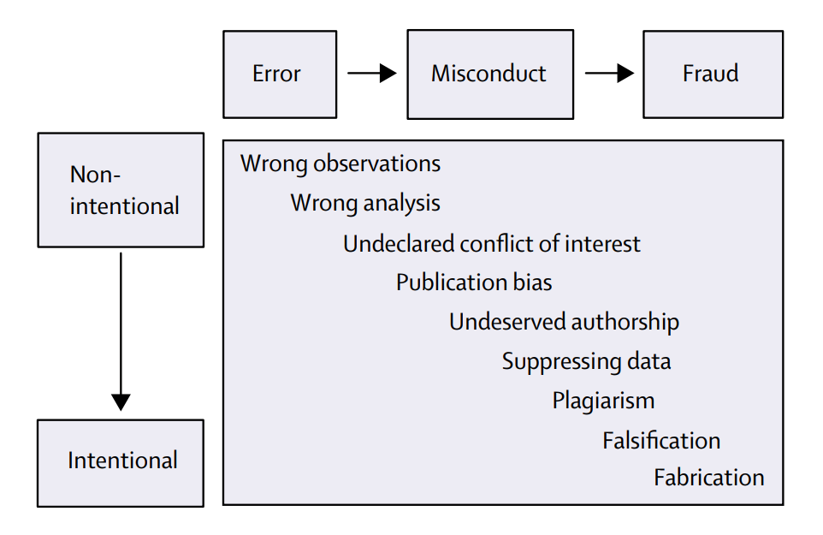
Slippery slope between honest errors and intentional fraud

Slide 19
Top 20 Iranian affiliations with the most retracted publications in PubMed- till 2017
Mansourzadeh MJ, Ghazimirsaeid J, Motamedi N, Najafi A, Abubakar AA, Dehdarirad H. A survey of Iranian retracted publications indexed in PubMed. Iranian Journal of Public Health. 2021 Jan;50(1):188.

Slide 20
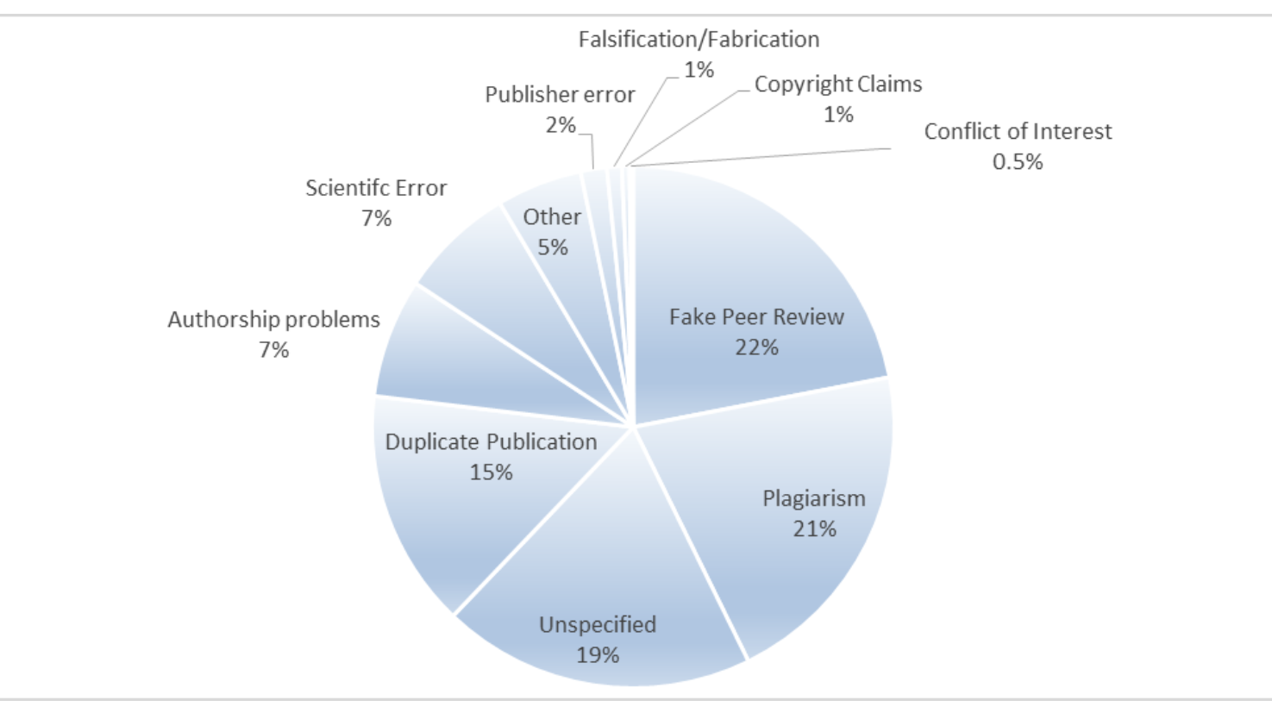
The share of reasons of Iranian retractions.
Ghorbi A, Fazeli-Varzaneh M, Ghaderi-Azad E, Ausloos M, Kozak M. Retracted papers by Iranian authors: causes, journals, time lags, affiliations, collaborations. Scientometrics. 2021 Sep;126(9):7351-71.
Notes:
This study aims to analyze 343 retraction notices indexed in the Scopus database, published in
2001–2019, related to scientific articles (co-)written by at least one author affiliated with an
Iranian institution.

Slide 21
How often is misconduct detected?
PubMed retractions : 0.02%
Image manipulation in Journal of Cell Biology: 1% (8/800)
Food and Drug Administration audit (investigators guilty of serious scientific misconduct): 2%
Notes:
https://publicationethics.org/resources/elearning/how-often-misconduct-detected

Slide 22
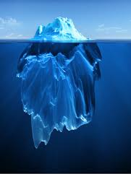
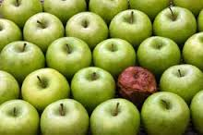
“A few bad apple” or “tip of iceburg”?

Slide 23
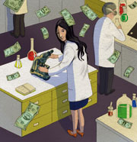
Ghost Author
"Ghost authoring" refers to making substantial contributions without being identified as an author.
Medical ghostwriters are employed by pharmaceutical companies and medical-device manufacturers to produce apparently independent manuscripts for peer-reviewed journals.

Slide 24

Guest Author
"Guest authoring" refers to being named as an author without having made substantial contributions.
A study published in the BMJ found that 21% of papers published in 2008 in six major medical journals had guest or ghost authors.
A similar study undertaken in 1996 found prevalence of 29%

Slide 25

Simultaneous submission of manuscripts
Authors may not send the same manuscript to more that one journal at the same time.
Why is it unethical?
Notes:
If the editor learns of possible simultaneous submission, may return the article without review, or may reject it without regard to the reviews, or make this decision in discussion with the other editor(s) involved, and may decide to consider no articles from the author from the authors for a period of time,

Slide 26
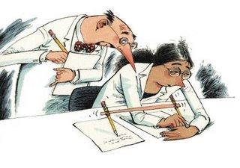
Plagiarism
Plagiarism is the use of others’ published and unpublished ideas or words (or other intellectual property) without attribution or permission, and presenting them as new and original rather than derived from an existing source.

Slide 27
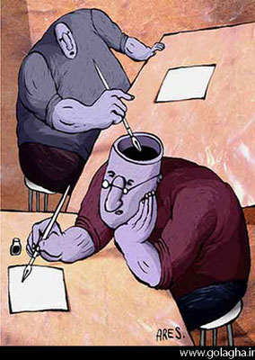
Forms of Plagiarism
Careless paraphrasing
Poor documentation
Inappropriate assistance
Recycling

Slide 28
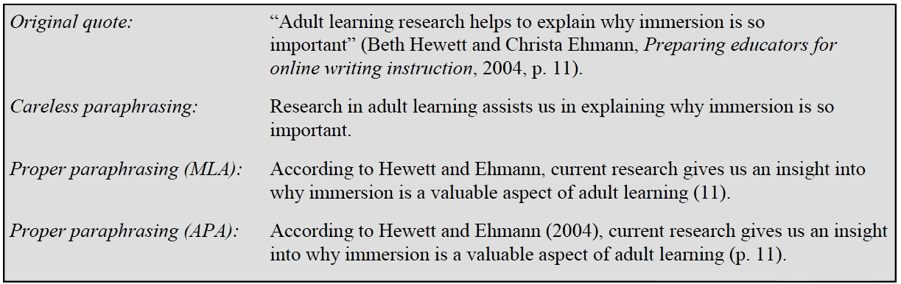
1. Careless paraphrasing
This occurs when the text is not paraphrased well. Changing a few words throughout an otherwise untouched quote does not make it a paraphrase.
Notes:
The Modern Language Association (MLA) style is the leading style of documentation for literary research, as well as academic papers in the humanities field.
The American Psychological Association (APA) style is, originally, a set of rules that authors use when submitting papers for publications in the journals of the APA.

Slide 29
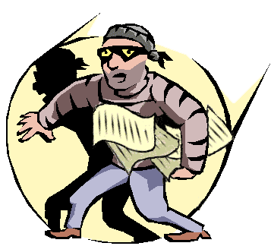
Inappropriate paraphrasing
making ‘cosmetic’ changes to the borrowed material, such as changing one or two words, simply rearranging the order, voice (i.e., active vs. passive) and/or tense of the sentences is NOT paraphrasing.

Slide 30
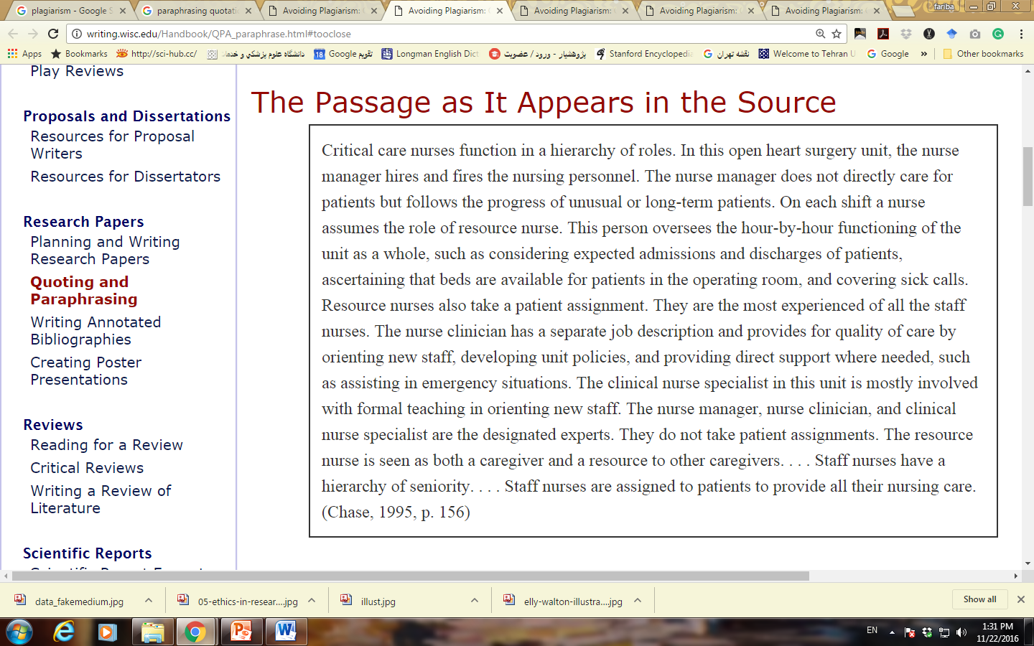
paraphrasing
Original Passage

Slide 31
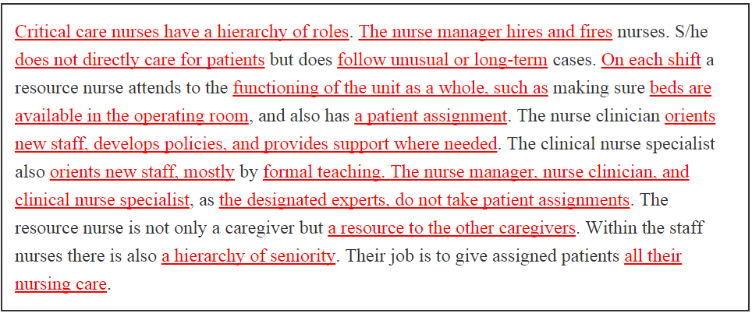
Word-for-Word Plagiarism

Slide 32
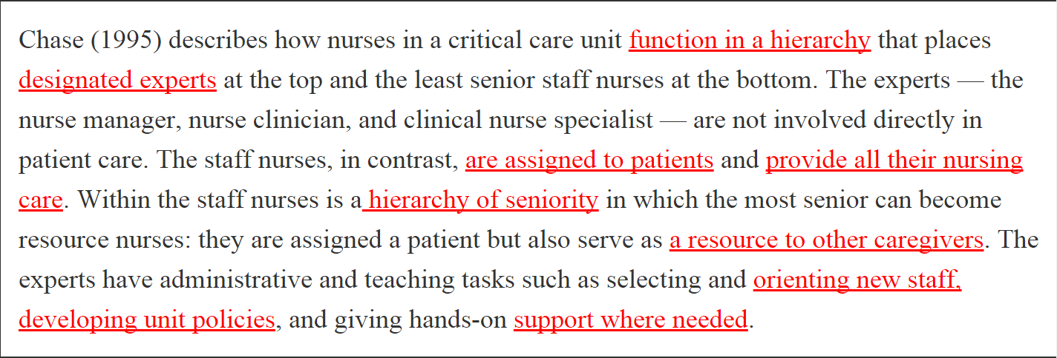
A Patchwork Paraphrase

Slide 33
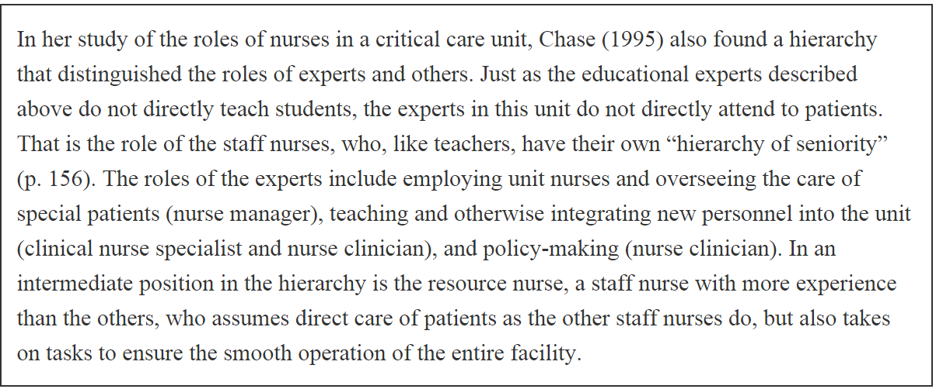
Legitimate Paraphrase

Slide 34
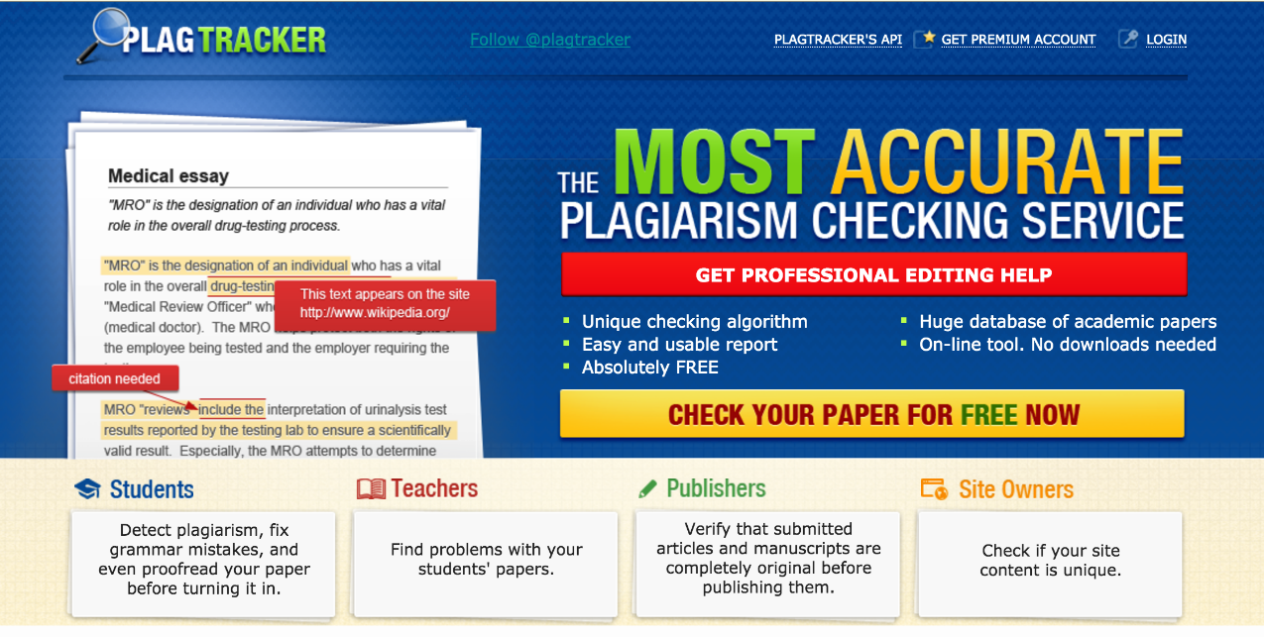
Plagiarism ckeck
Identicate
Tblast
Crosscheck
Turnitin
Plagtracker
…

Slide 35
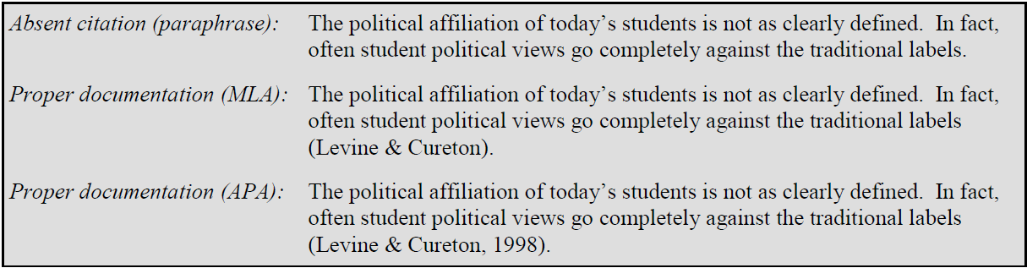
2. Poor documentation
incomplete citations, absent citations, or overstretched citations

Slide 36
citation
Always cite the actual worked that is consulted. When the published paper cannot be obtained, cite the specific version of the material being used whether it is conference presentation, abstract, or an unpublished manuscript.
Ensure that the cited work has not been subsequently corrected or retracted.

Slide 37

3. Inappropriate assistance
Paper mill
Authorship for sale

Slide 38
3. Inappropriate assistance
This can range from asking a family member or a friend to write a section of the paper for you to paying a person or an organization to produce a complete (original) paper.
Each paper you write is expected to be a product of your own original thoughts. Presenting a work produced by somebody else as your own (even with their expressed consent) is plagiarism.

Slide 39
4. Recycling
Resubmitting the same piece of writing for a different paper is self plagiarism or recycling.
Redundant
Duplicate

Slide 40
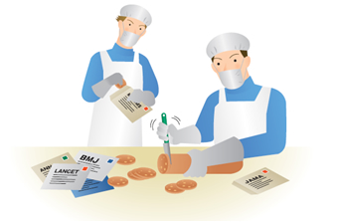
Redundant publication
Salami Slicing
to publish articles that overlap substantially with articles published elsewhere.
The other papers should be cited.

Slide 41
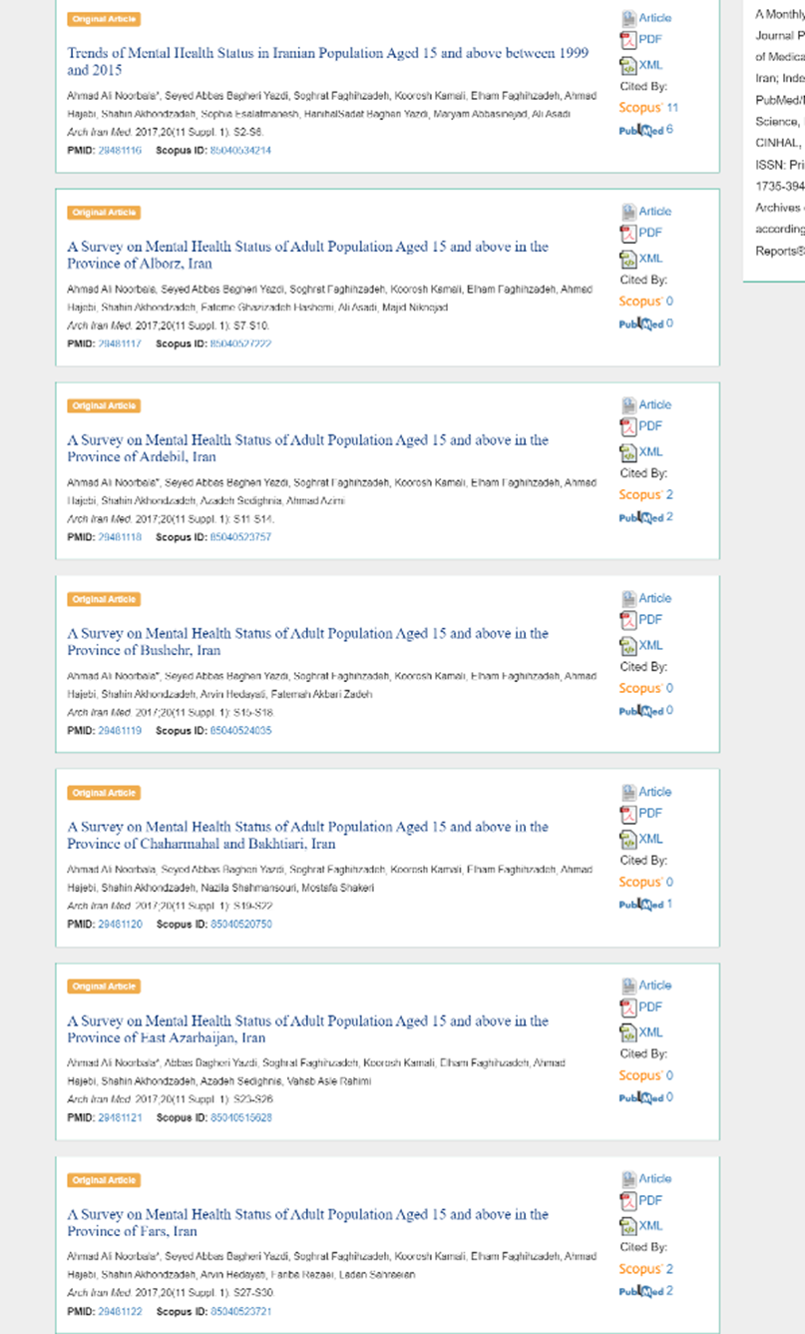
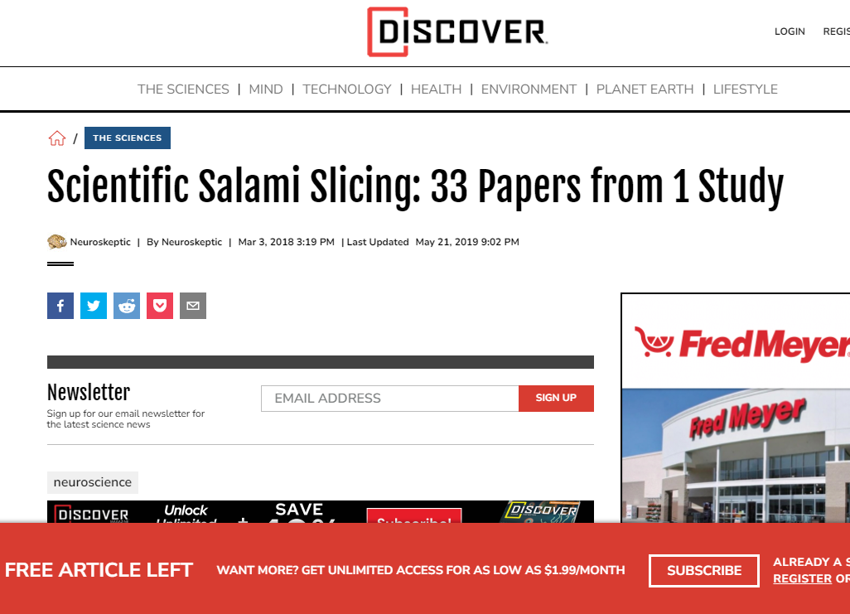
Salami slicing

Slide 42
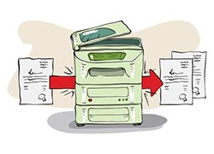
Duplicate publication
Duplicate publication is the publication of the same article or substantially similar articles in more than one journal.

Slide 43
Acceptable secondary publication
Paper that has been presented at a scientific meeting but was not published in full
guidelines produced by governmental agencies and professional organizations, may need to reach the widest possible audience.

Slide 44
Duplicate Submission in different languages
The authors have received approval from the editors of both journals (the editor concerned with secondary publication must have access to the primary version).
The title of the secondary publication should indicate that it is a secondary publication (or translation) of a primary publication.

Slide 45
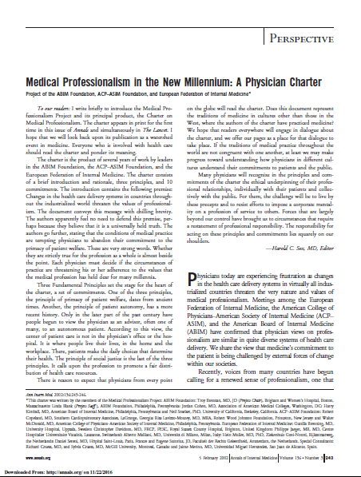
Sample
This paper was published in 13 journals in less than 1.5 years.
Annals of Internal Medicine
The Lancet
Clinical Medicine (formerly Journal of the Royal College of Physicians),
European Journal of Internal Medicine,
American Journal of Obstetrics and Gynecology,
The American Journal of Surgery,
Journal of the American College of Dentists,
Annals of the Royal College of Physicians and Surgeons of Canada,
Canadian Medical Association Journal,
The Medical Journal of Australia,
Bollettino Ordine Provinciale Medici Chirurghi e Odontoiatri-Milano,
La Revue de Médecine Interne
La Radiologia Medica

Slide 46
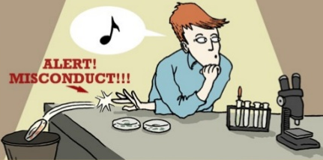
Falsification of data
ranges from fabrication to deceptive selective reporting of findings and omission of conflicting data, or willful suppression and/or distortion of data.

Slide 47
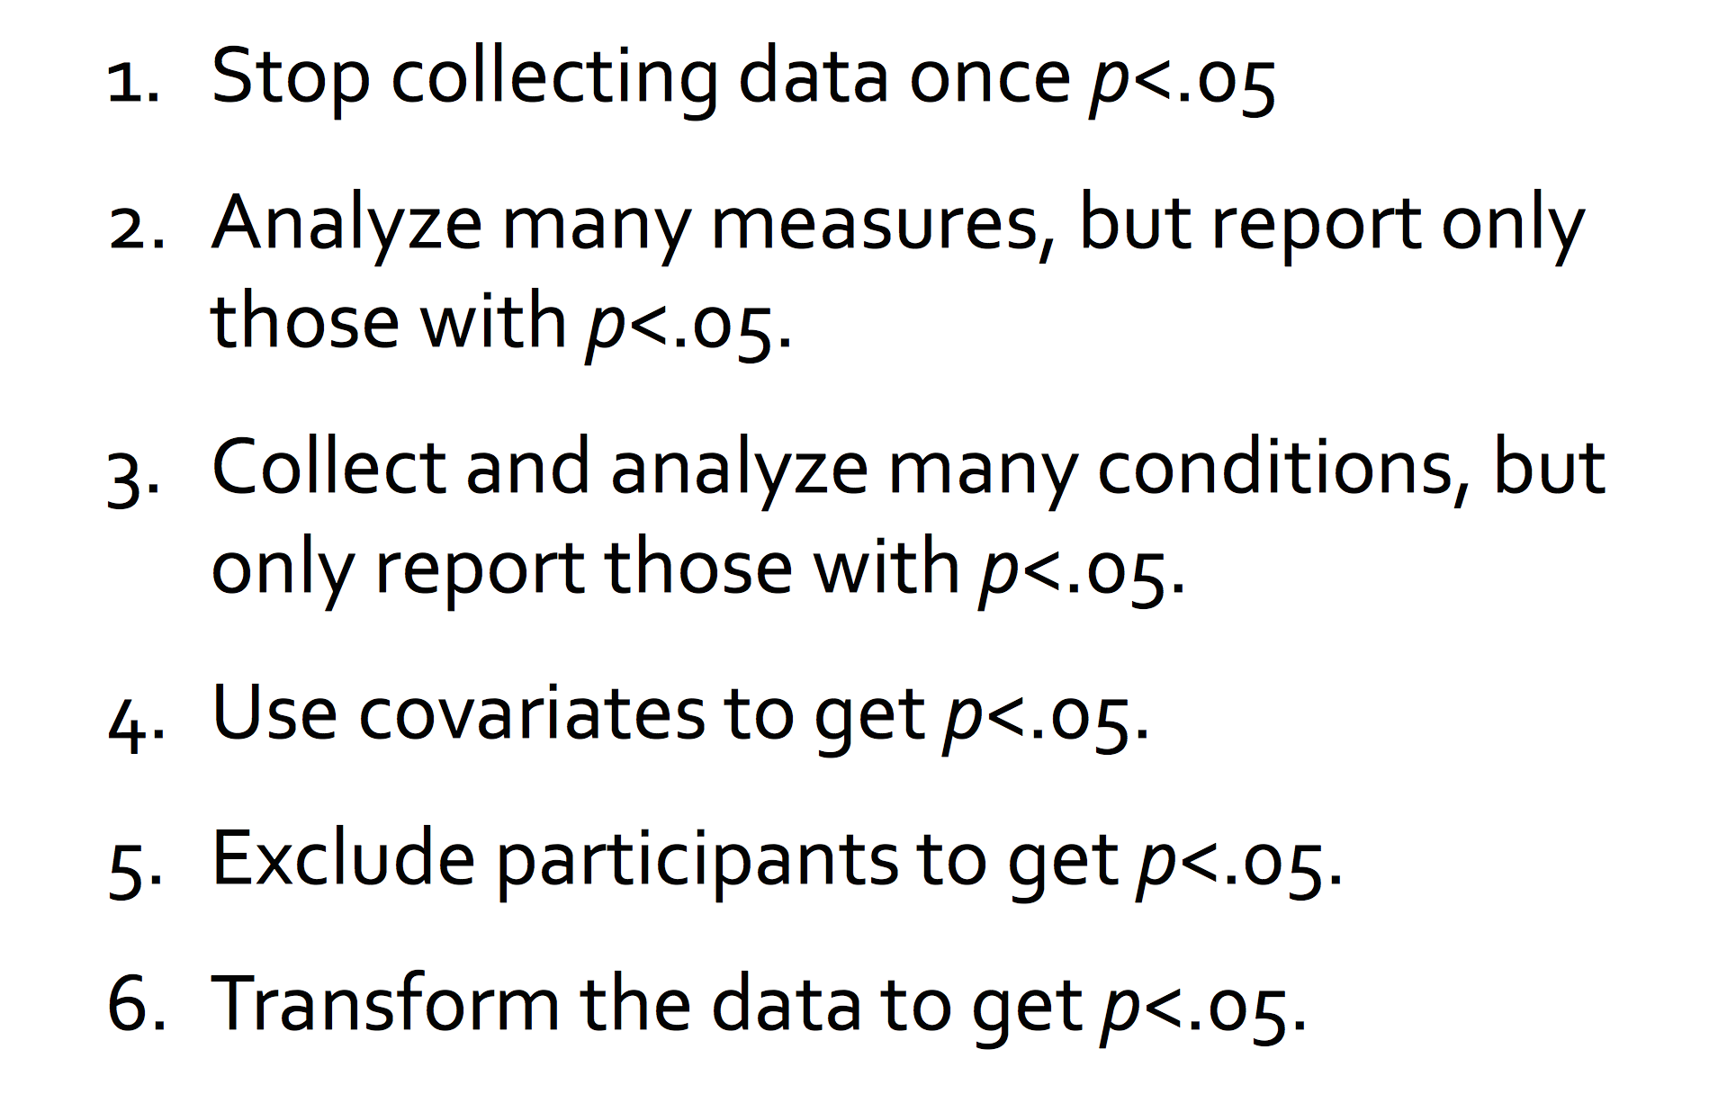
P-Hacking

Slide 48
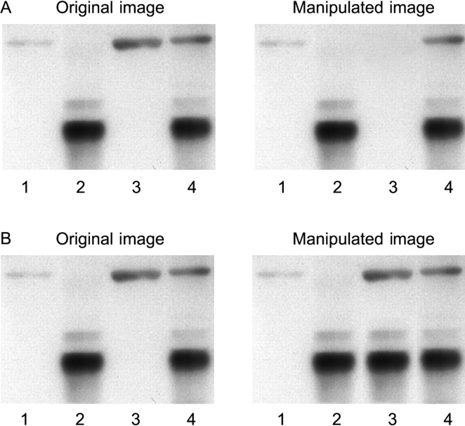
It‘s so easy to add and subtract with Photoshop
M. Rossner and K. Yamada, JCB, 2004

Slide 49
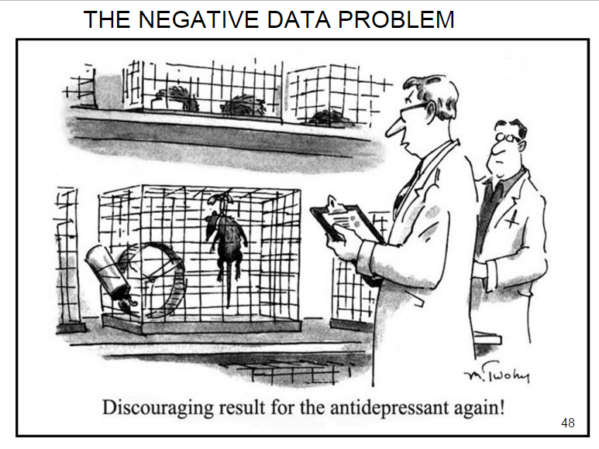
Publication Bias
Failure to submit or publish findings because of lack of statistical significance is an important cause of publication bias.
Editors should consider for publication any carefully done study of an important question, relevant to their readers, whether the results are statistically significant.

Slide 50

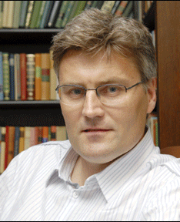
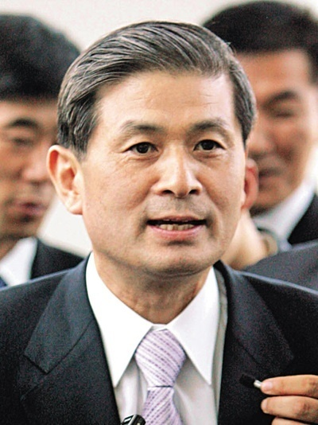
Data Fabrication
Scott Reuben -2009
Jon Sudbø-2006
Woo-suk Hwang-2006
Notes:
Hwang: he reported he had succeeded in creating human embryonic stem cells by cloning. Reuben's 21 fraudulent articles

Slide 51
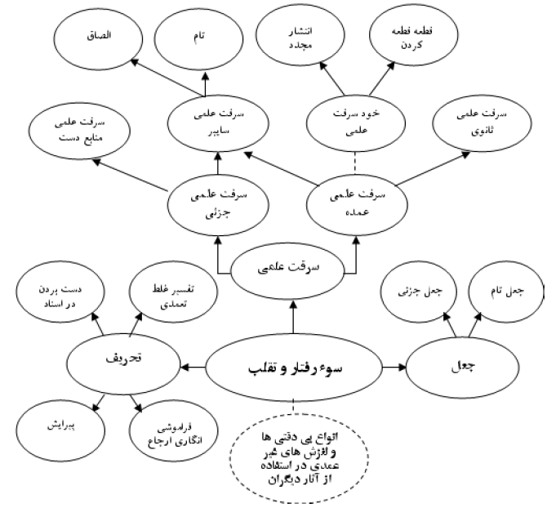

Slide 52
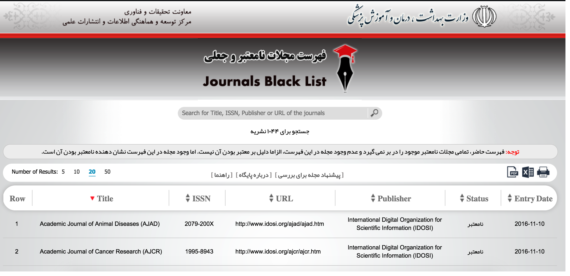
Fake journals
http://blacklist.research.ac.ir/#

Slide 53
Warning signs
The journal has no address or contact information other than an email address listed.
There are articles listed but no evidence of an editorial board to review those articles.
The website has an overwhelming number of images from major publishers who would have no reason to partner with this journal.
The editorial board seems to contain very prominent researchers who would be too busy to work with an unknown journal.
There is no mention of an APF, which means you’ll likely receive an outrageous bill after your article has been rapidly accepted for publication.
There is no mention of a peer review process or basic submission requirements.

Slide 54
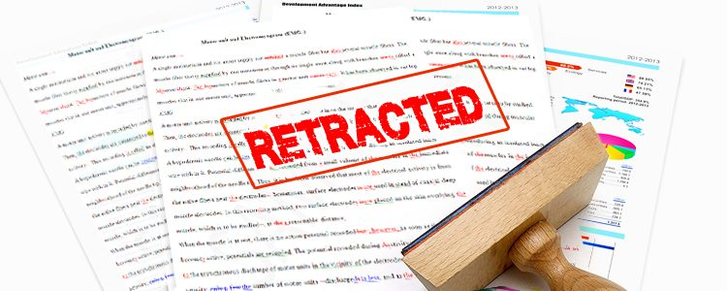
Impact of Publication misconduct

Slide 55
Impact of Publication misconduct
788 retracted English-language papers published from 2000 to 2010
9 out of 10 were clinical trial
7 out of 10 were because of fraud.
Retracted papers were cited 30.6 times per retracted paper. 36% of citations were after retraction.
In overall 70501 patients were treated in secondary studies influenced by a primary paper that was retracted
Steen RG. Retractions in the medical literature: how many patients are put at risk by flawed research?. Journal of Medical Ethics. 2011 Nov 1;37(11):688-92.

Slide 56

Any Question?

